Slide 1
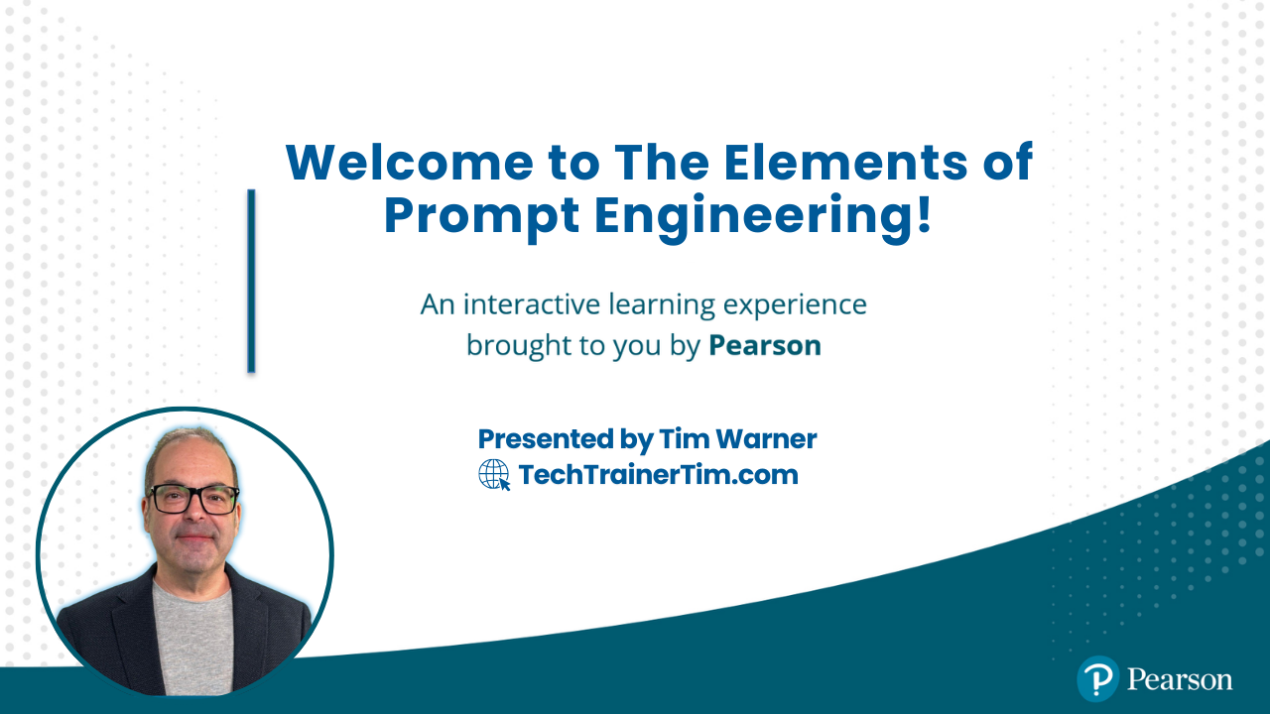




The Elements of Prompt Engineering
Tim Warner
Microsoft MVP, Azure AI Platform
TechTrainerTim.com

Slide 2
Session Materials
timw.info/elements

Slide 3
Class Schedule (Central Time)
09:00 am - Start - Segment 1: LLM & Prompting Fundamentals
10:00 am - 9-min Break - Segment 2: Data Analysis & Projects
11:00 am - 9-min Break - Segment 3: Assistants & Agents
12:00 pm - 9-min Break - Segment 4: Development & Trends
01:00 pm - Finish

Slide 4
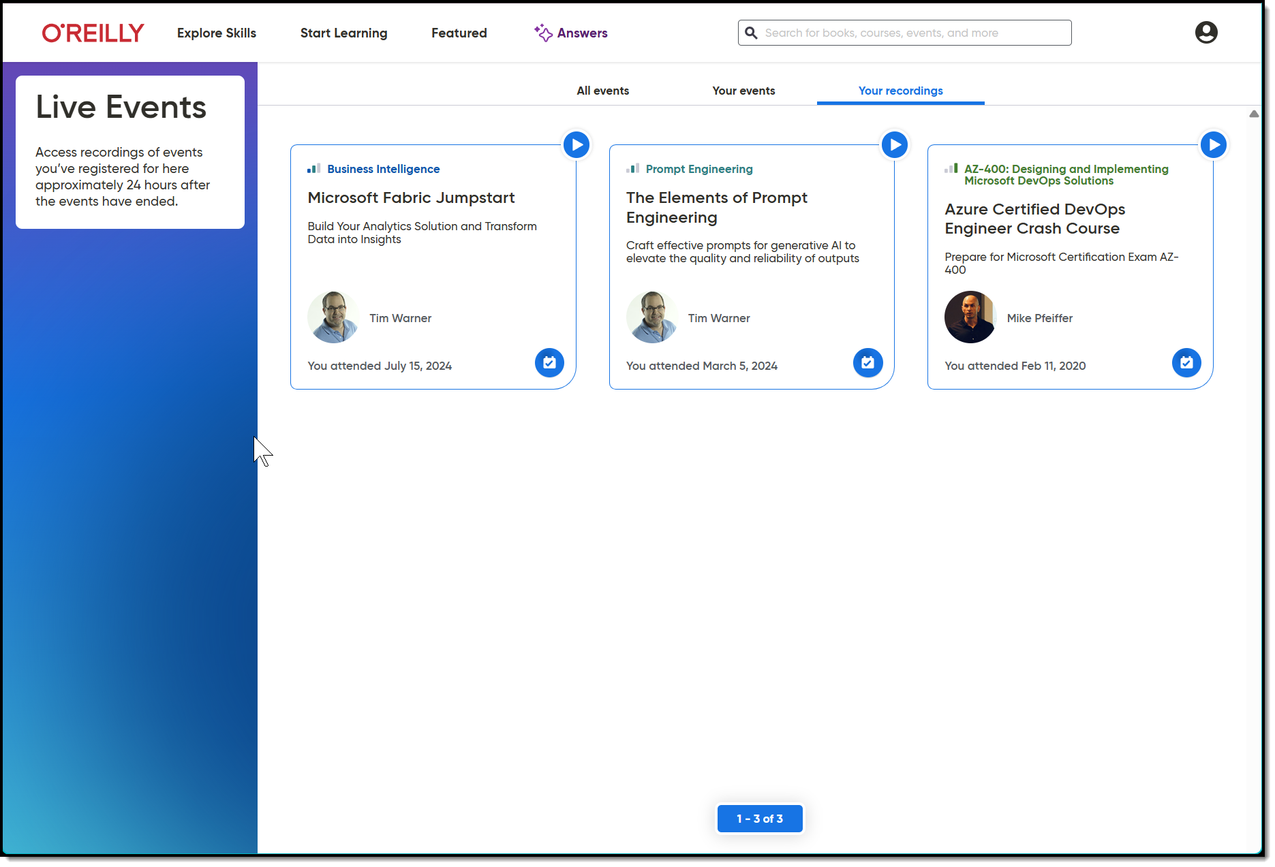
Session Recording & Badge

Slide 5
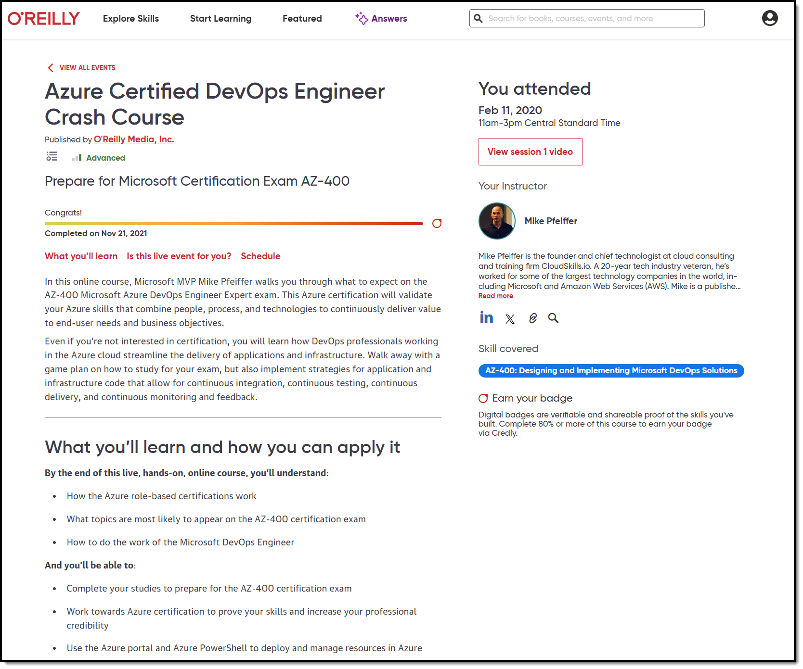
Session Recording & Badge

Slide 6
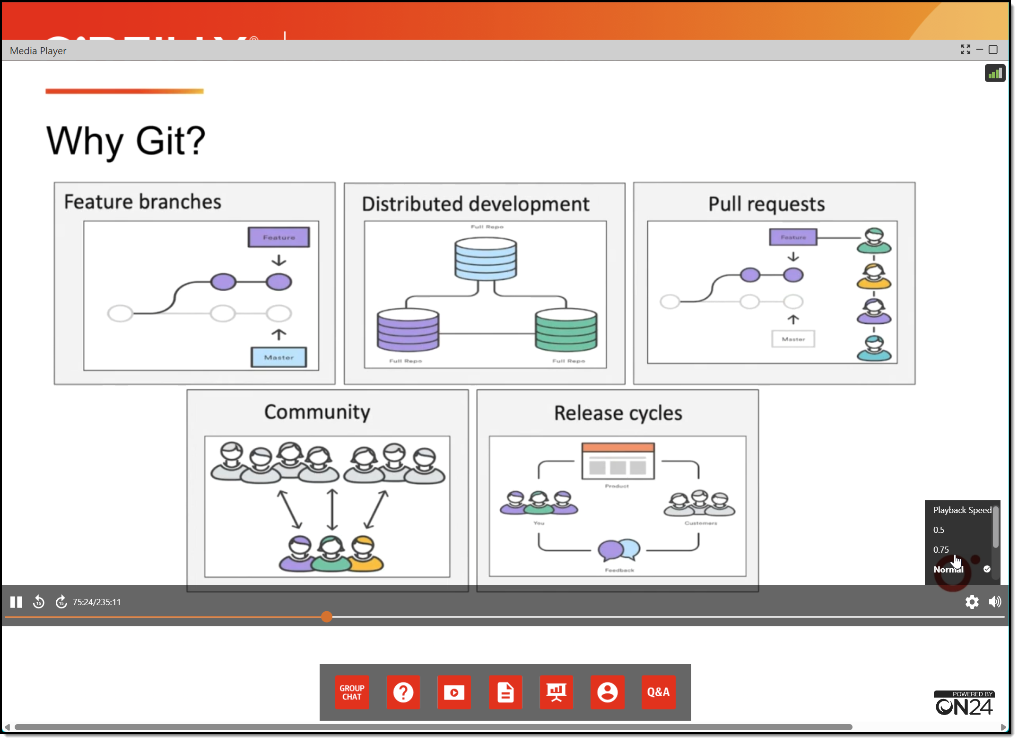
Session Recording & Badge

Slide 7
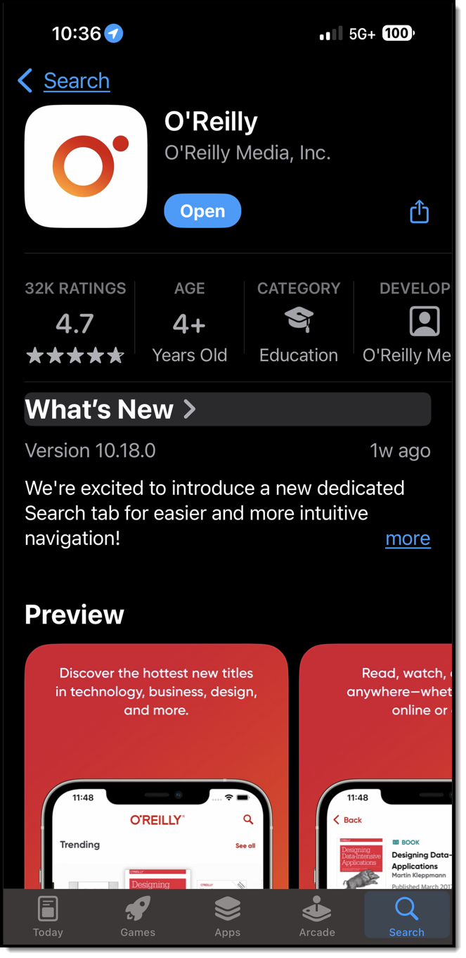
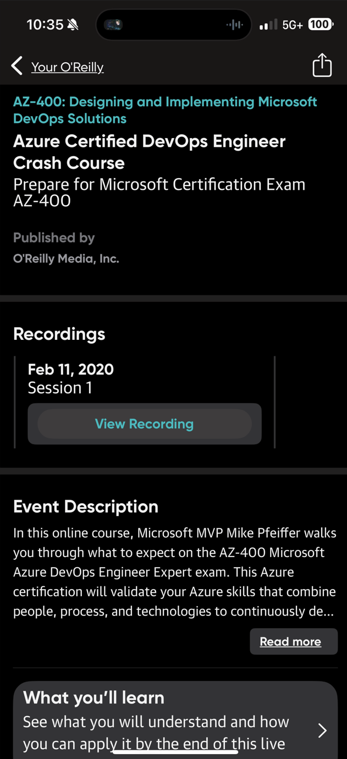
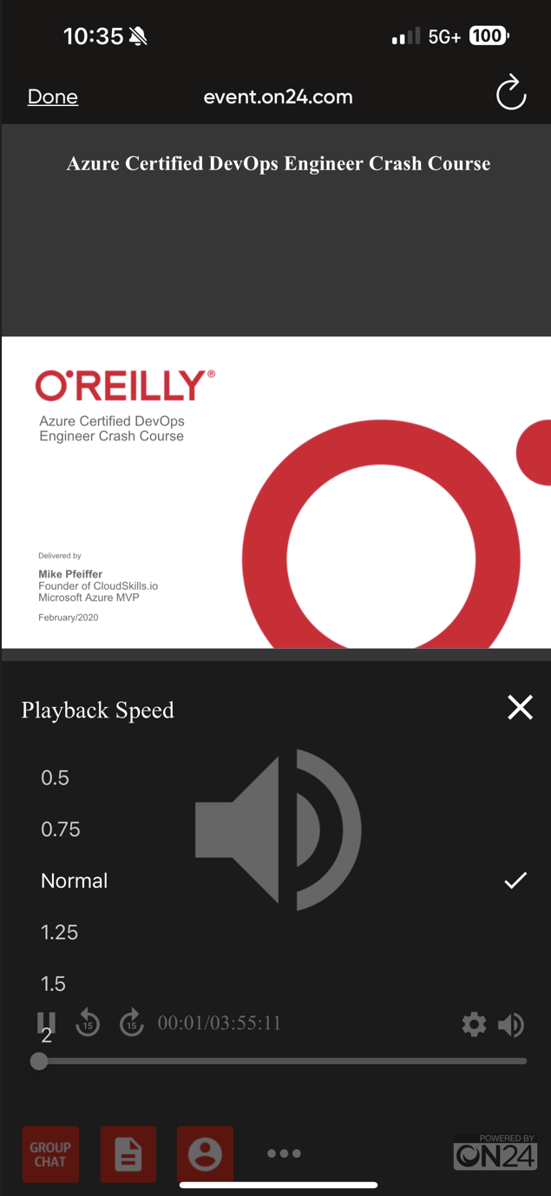
Session Recording & Badge

Slide 8
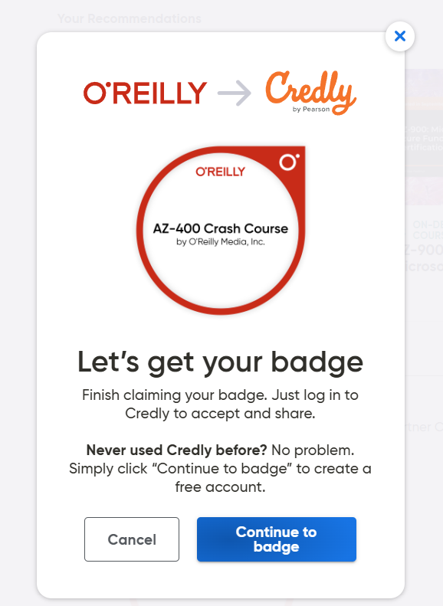
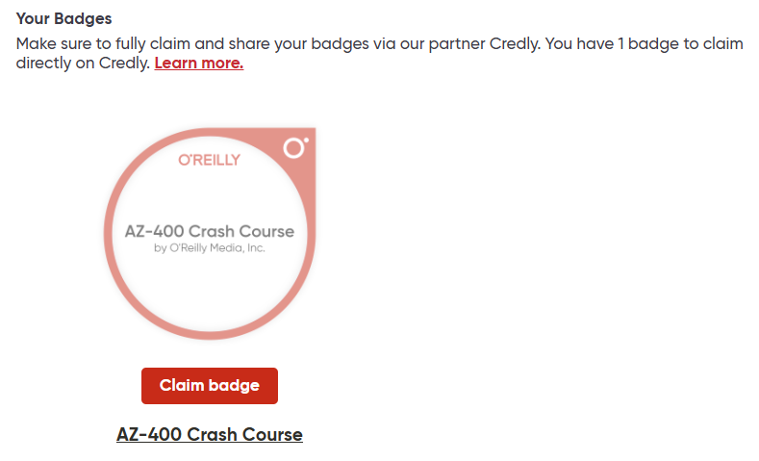
Session Recording & Badge

Slide 9
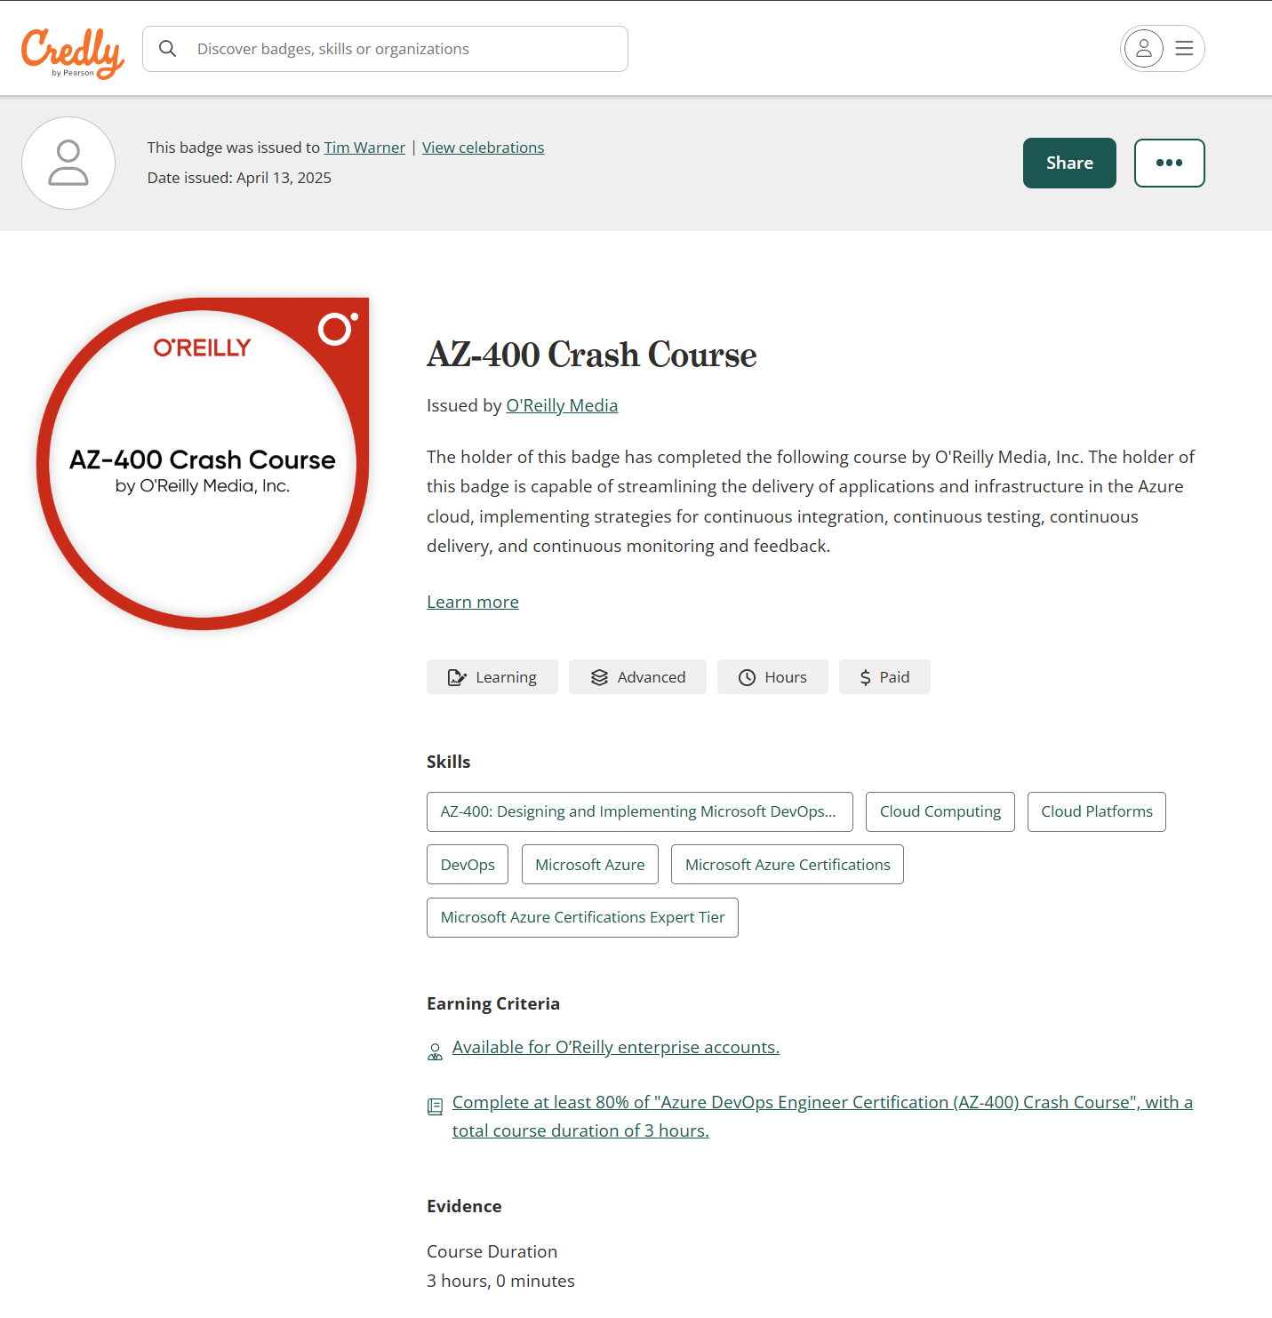
Session Recording & Badge

Slide 10
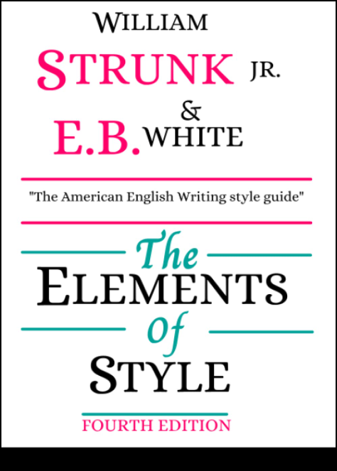
Tim's Essential Tech Writing Bookshelf

Slide 11
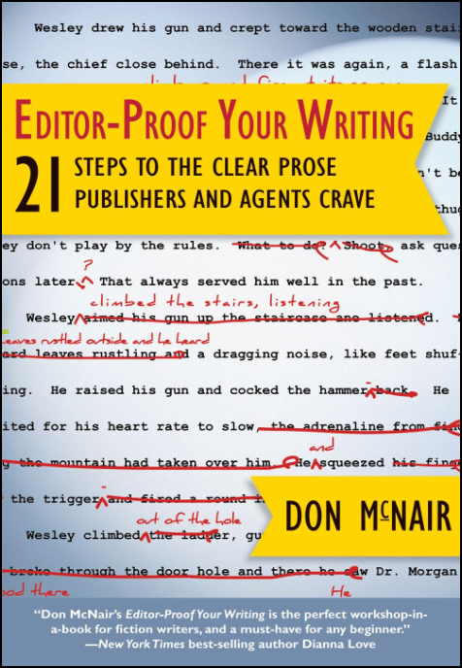
Tim's Essential Tech Writing Bookshelf

Slide 12

Tim's Essential Tech Writing Bookshelf

Slide 13
Conceptual Diagrams

Slide 14
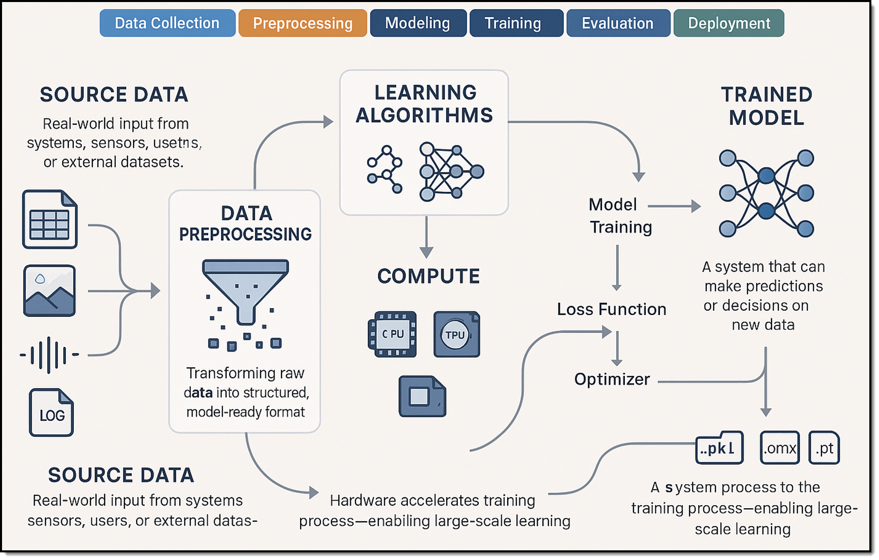
Machine Learning (ML) lifecycle
Notes:
I generated the image with my prompt in my personal ChatGPT account using their latest image-gen model. Did that on Wed, 3/26/2025 at 3pm Central or thereabouts.

Slide 15
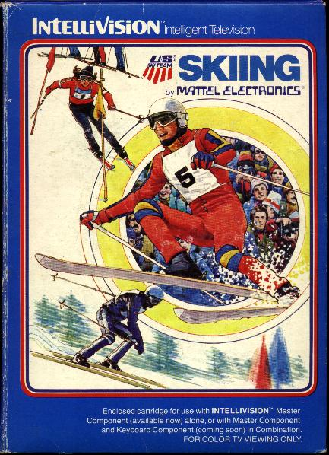
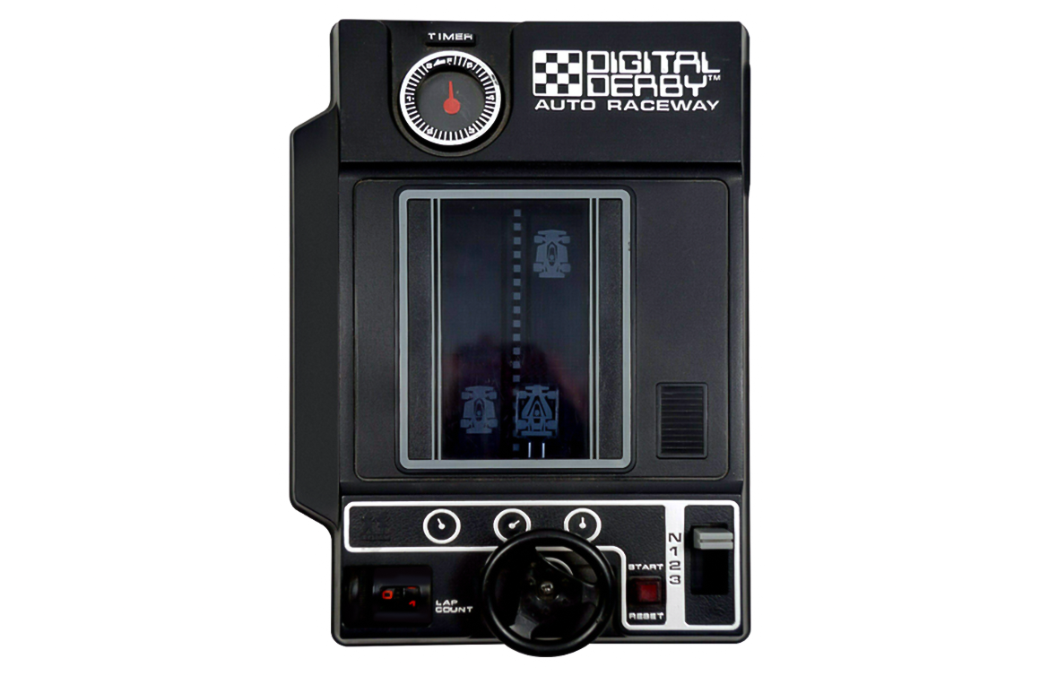
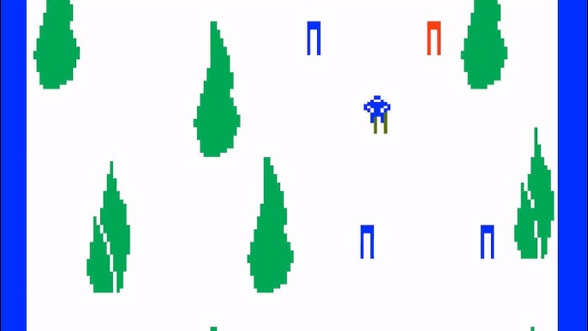
Keeping an LLM on task be like…

Slide 16
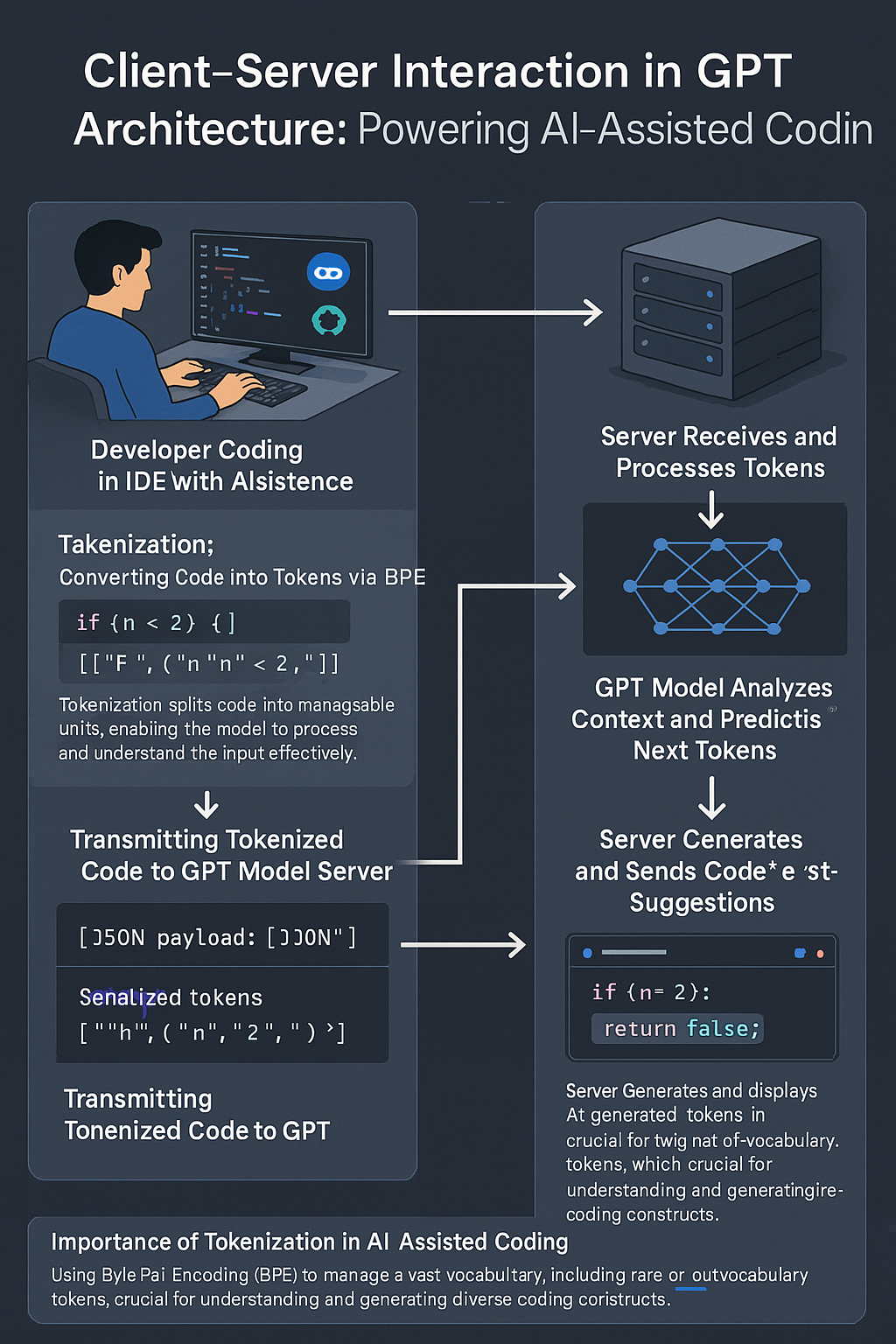
GPT Basic Architecture
OpenAI GPT 4o Image Generation
Multimodal generative AI
Two ways to improve model:
Fine tuning
Retrieval Augmented Generation (RAG)

Slide 17
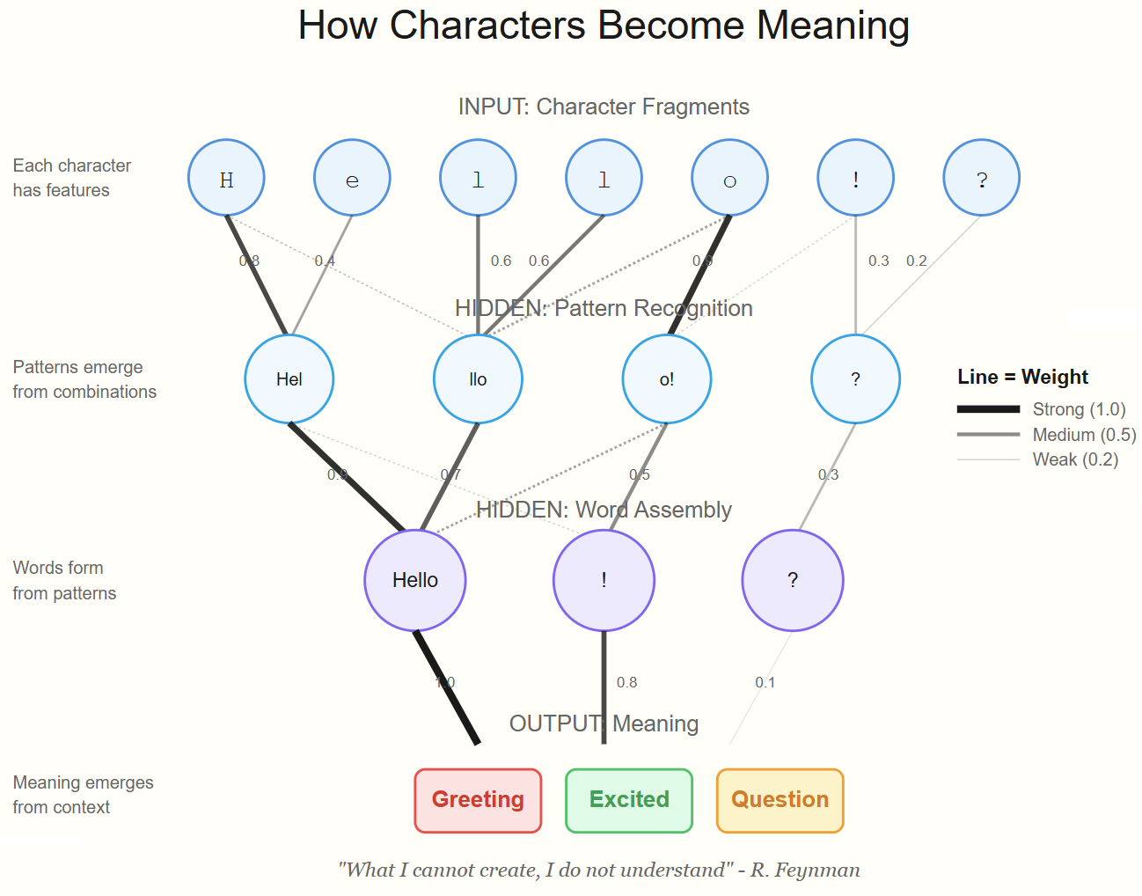
Neural Network
Notes:
Image credit: Tim + Claude AI

Slide 18
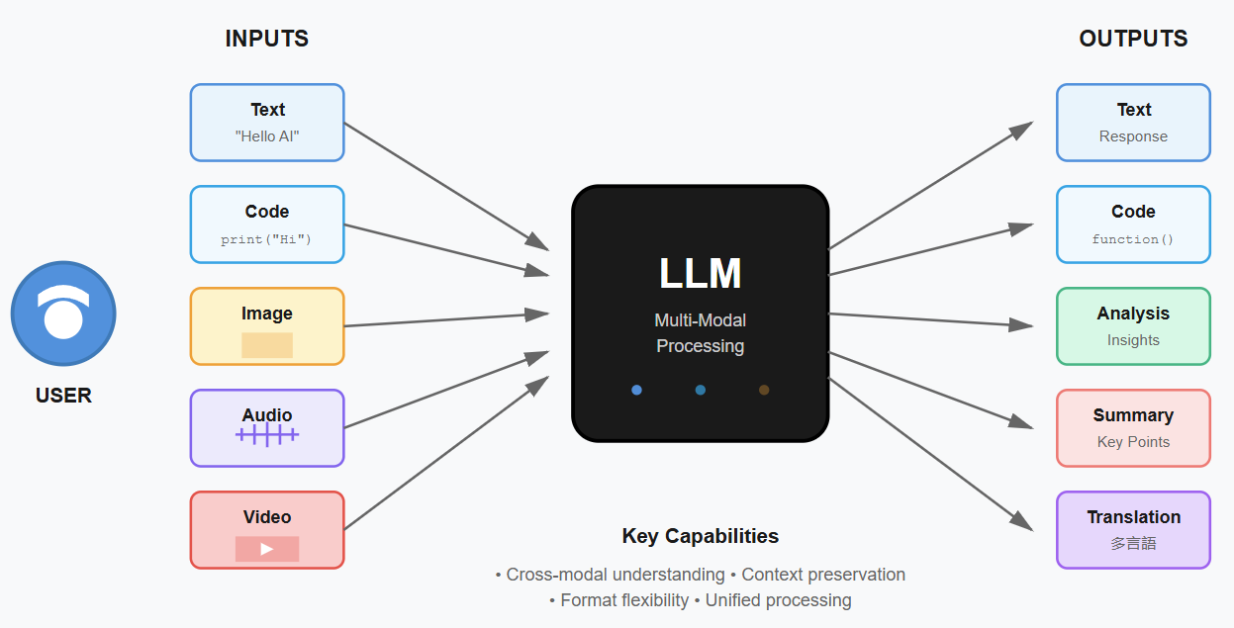
LLM Multi-Modal Processing
Notes:
Image credit: Tim + Claude AI

Slide 19
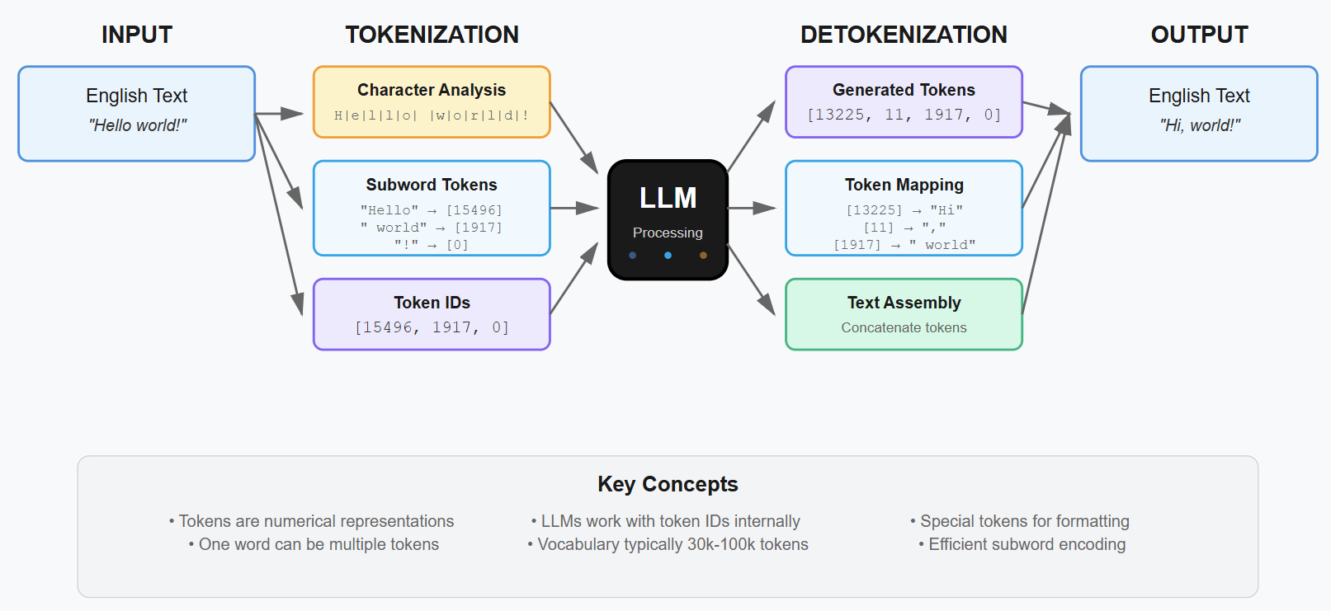
Tokenization Process in LLMs

Slide 20
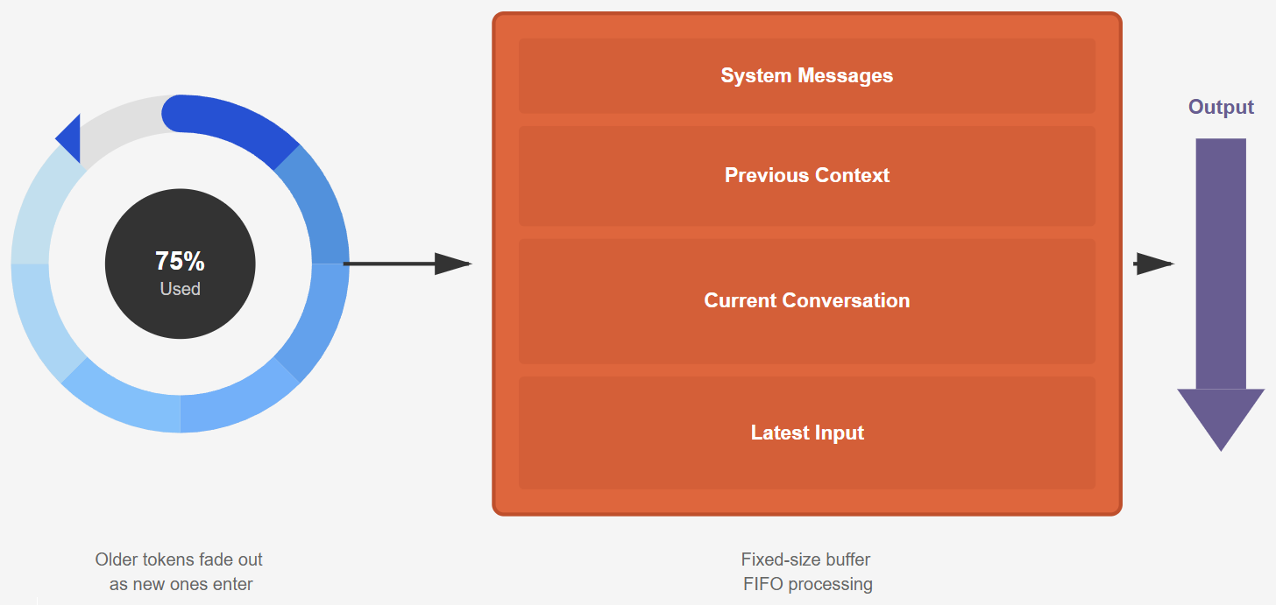
Context Window
Notes:
Illustration credit: Tim

Slide 21
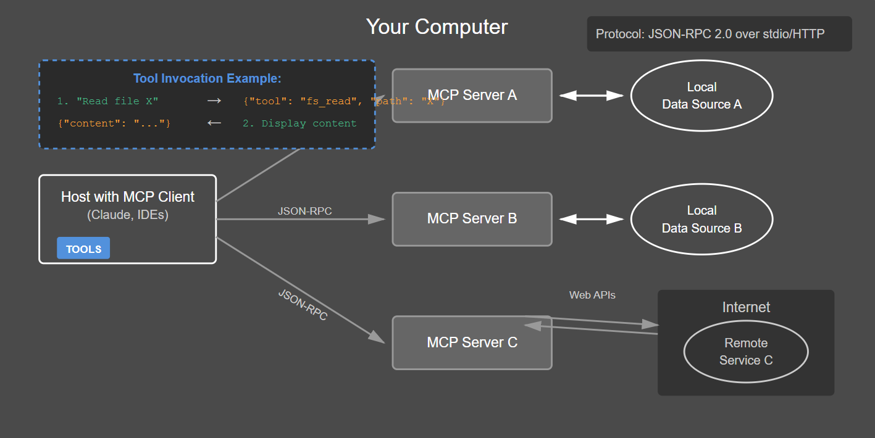
Model Context Protocol (MCP) by Anthropic
modelcontextprotocol.io
Notes:
Image credit: Tim + Claude AI

Slide 22
LLM Prompting Frameworks

Slide 23
Microsoft GOAL Prompting
G: Goal – What do you want to accomplish?
e.g., “Summarize customer feedback trends.”
O: Output – What should the LLM generate?
e.g., “Bullet points with sentiment tags.”
A: Audience – Who will consume this?
e.g., “Executive team reviewing QBR deck.”
L: Length – How detailed or concise?
e.g., “No more than 5 bullets.”

Slide 24
Google GRAIL Prompting
G: Goal – What’s the end result you want?
e.g., “Draft a welcome email for new users.”
R: Role – What role should the model play?
e.g., “Act as a product marketing manager.”
A: Audience – Who are you speaking to?
e.g., “Tech-savvy Gen Z freelancers.”
I: Input – What context are you providing?
e.g., “Onboarding flow screenshot + benefits list.”
L: Limitations – Any tone or style constraints?
e.g., “Use friendly, concise, no buzzwords.”

Slide 25
GitHub HAIL Prompting
H: How – What structure or format do you need?
e.g., “Output as a Markdown table.”
A: Audience – Who is the reader or user?
e.g., “Beginner Python developers.”
I: Intent – What task are you trying to solve?
e.g., “Teach how to use list comprehensions.”
L: Limits – Are there rules or boundaries?
e.g., “Exclude examples that use external libraries.”

Slide 26
Responsible AI RAIL Prompting
R: Responsibility – Does this respect safety, privacy, fairness?
e.g., “Avoid stereotypes when describing users.”
A: Accountability – Who owns this output and its use?
e.g., “Label outputs for human review before publishing.”
I: Inclusiveness – Is the result accessible and inclusive?
e.g., “Use gender-neutral language.”
L: Legality – Are you avoiding IP violations, TOS breaches?
e.g., “No use of copyrighted song lyrics.”

Slide 27

Questions? Comments? Curiosities?

Slide 28

Thank You! Thank You Very Much...
Resources: timw.info/elements
Connect: TechTrainerTim.com

Slide 29
Specific Prompting Guidance

Slide 30

Omit Needless Words
Elements of Style: "Vigorous writing is concise. A sentence should contain no unnecessary words, a paragraph no unnecessary sentences..."
AI prompting: Avoid overly complex or wordy prompts. State your intention directly
Instead of "Generate a detailed oil painting of a majestic lion with a flowing mane, standing proudly on a windswept savanna at sunset,"
try "Oil painting of a majestic lion on a savanna at sunset."

Slide 31
Cut the Fluff
Problem: Excess words clutter prompts and distract the AI from the core request.
Solution: Be ruthless! Eliminate unnecessary descriptors and focus on the essence of your desired output.
Original prompt: "I would like a whimsical illustration featuring a mischievous raccoon in a quaint, moonlit forest, engaged in the act of foraging for tasty treats."
Fog-free revision:
"Illustration of a raccoon."
"Forest at night, moonlight."
"Raccoon searching for food."

Slide 32
Short, Direct Sentences
Problem: Overly long, complex prompts can confuse the AI, leading to unintended results.
Solution: Break your requests into shorter phrases. Instead of "I would like a detailed landscape painting featuring a winding river leading to a majestic mountain range with a vibrant sunset casting warm, orange hues across the sky," try:
"Landscape painting."
"Winding river."
"Majestic mountains."
"Vibrant sunset, orange colors."

Slide 33
Specificity Over Vagueness
Elements of Style: "Put the emphasis on the right word."
AI prompting: Be precise as possible with your descriptions, adjectives, and desired styles. Instead of "Generate an image of a building," consider "Generate a photorealistic image of a Brutalist skyscraper with sharp angles."

Slide 34
Active Voice
Elements of Style: "Use the active voice... The active voice is usually more direct and vigorous..."
AI prompting: Try phrasing prompts as direct commands or requests. Instead of "A picture of a dog running on the beach would be nice," use "Generate a photograph of a dog running on a beach."

Slide 35
Artistic Style as Guidance
Elements of Style: Doesn't directly address this, but the concept of style choices resonates.
AI prompting: Referencing artistic styles, movements, and well-known artists can be incredibly powerful in guiding AI image generators. For example: "A Van Gogh-inspired landscape pastel painting of rolling hills" or "A portrait of a woman in the style of Art Deco."

Slide 36
Consistency and Structured Requests
Elements of Style: Although the book discusses prose, the underlying need for order and logic applies.
AI prompting: Experiment with creating a consistent prompt structure to help the AI understand your requests. For example:
Medium: Painting, sketch, digital art, pixel art
Subject: Object, person, landscape
Style: Impressionist, surrealist, minimalist
Specific Details: Colors, lighting, mood

Slide 37
Additional Considerations
Iterate and refine: Just like good writing, AI prompting requires revision. Start basic, then add details as you analyze the output.
Understand AI model strengths: Different AI models excel in different areas. A model trained for photorealism might struggle with abstract concepts.

Slide 38
The Role of Verbs
Elements of Style: "The verb is the heart of the sentence."
AI prompting: Think about the action or state you want to convey. Instead of "A photo of a cat," try "A cat perched on a windowsill, watching birds" or "A cat playfully batting at a ball of yarn." Dynamic verbs can transform a static image into something much more engaging.

Slide 39
The Rule of Position
Elements of Style: "The writer... must take the utmost pains to see that the most important word is in the slot where it has the most weight."
AI prompting: Consider the overall composition you desire. The order of elements in your prompt can influence the AI's focus.
For example, "A cat with green eyes on a bookshelf" will likely emphasize the cat, while "A bookshelf overflowing with books, one featuring a cat with green eyes" may prioritize the setting.

Slide 40
Practical Tip
Keep a notebook or document to track successful prompts and analyze why they worked well.
You'll start to develop an intuitive understanding of how to communicate effectively with your chosen AI models.
Even better, consider hosting a centralized prompt repository like Tim's Prompt Sharing Framework (PSF) at GitHub:
timw.info/psf

Slide 41
Practice Projects for Prompting Proficiency

Slide 42
Project #1: Drug Discovery Inspirations
Objective: Generate novel ideas for drug discovery through creative prompting techniques.
Zero-Shot: 'Generate a list of innovative drug ideas for treating [specific condition], inspired by natural remedies.'
One-Shot: Provide the AI with a single example of an existing drug's development process.
Few-Shot: Give the AI multiple examples of drugs and their uses.
Role Play: 'Imagine you are a leading drug discovery scientist.'
Multimodal Integration (Future Use): 'Given the chemical structure images of [Drug A and Drug B].'

Slide 43
Project #2: Research Paper Summaries
Objective: Master summarization techniques for varied audiences.
Zero-Shot: 'Summarize the following research paper [title], focusing on its significance.'
One-Shot: After providing a simple summary example.
Few-Shot: Provide summaries of varying complexity.
Role Play: 'You are a journalist for a popular science magazine.'
Multimodal Integration: 'Analyze the graph from [paper title, figure number].'

Slide 44
Project #3: Patient Information Leaflets
Objective: Create accessible medical information using transformation techniques.
Zero-Shot: 'Transform the medical data sheet of [Drug A] into a patient-friendly information leaflet.'
One-Shot: Show an example of a transformed medical description.
Few-Shot: Provide several examples of technical descriptions.
Role Play: 'Pretend you're explaining [Drug A]'s benefits and side effects to a concerned patient.'
Multimodal Integration: 'Describe the best way to administer [Drug A].'

Slide 45
Project #4: Drug Interactions Checker
Objective: Utilize AI to predict and explain drug interactions.
Zero-Shot: 'List possible interactions between [Drug A] and [Drug B], and explain their clinical significance.'
One-Shot: Provide an example of a drug interaction description.
Few-Shot: Supply multiple interaction examples.
Role Play: 'Assume the role of a pharmacist. Explain to a patient how [Drug A] might interact.'
Multimodal Integration: 'Given the molecular structures of [Drug A and Drug B].'

Slide 46
Project #5: Marketing Material Generation
Objective: Craft compelling marketing narratives for healthcare products.
Zero-Shot: 'Generate a marketing brochure outline for [specific drug], targeting doctors and healthcare professionals.'
One-Shot: After providing an example of a product feature highlight.
Few-Shot: Provide several examples of marketing angles for different drugs.
Role Play: 'You're the marketing head at a pharmaceutical company. Draft a pitch for [Drug A].'Multimodal Integration: 'Design an infographic summarizing the benefits of [Drug A].'

